Slide 1
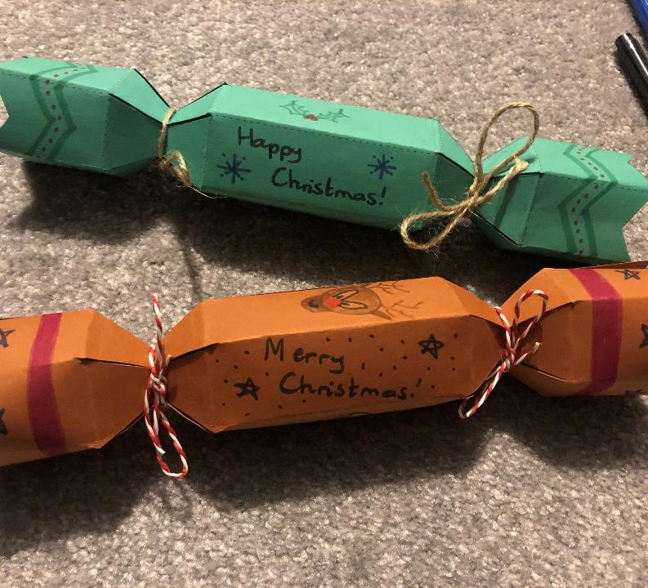
Eco-Friendly Christmas Crackers

Slide 2
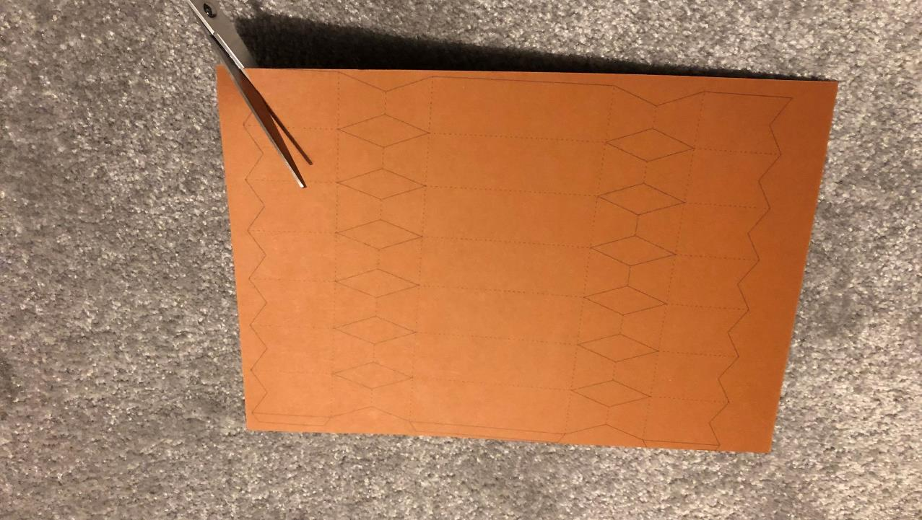
1. Cut along the solid lines (not the dotted ones!)

Slide 3
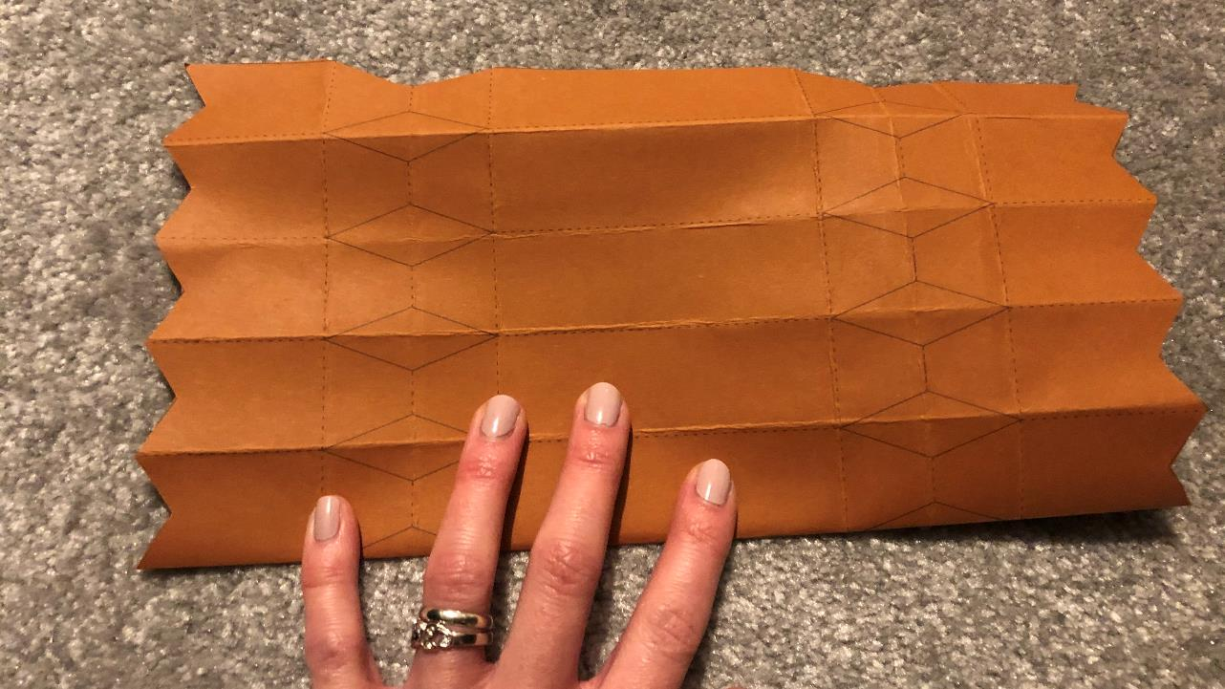
2. Fold along all the dotted lines (there are quite a lot of them!)

Slide 4
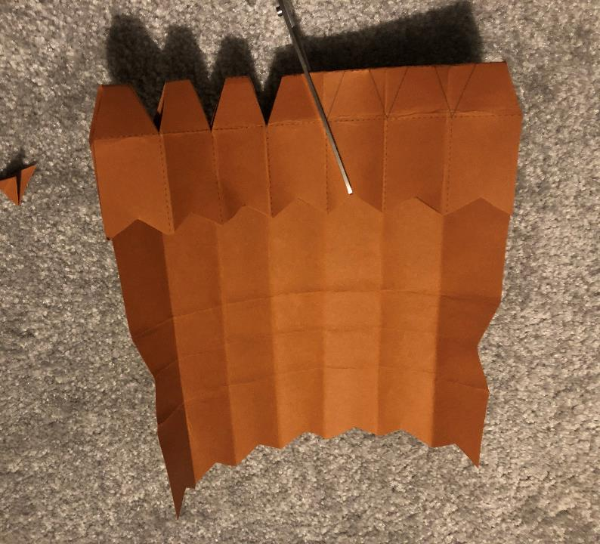
3. Fold across the middle of the diamond shapes on each side and cut them out.

Slide 5
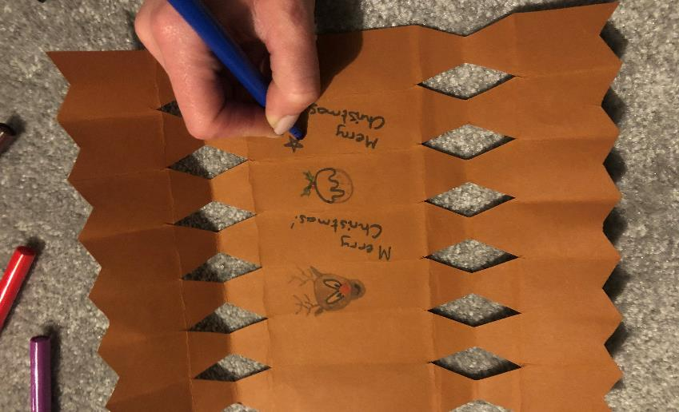
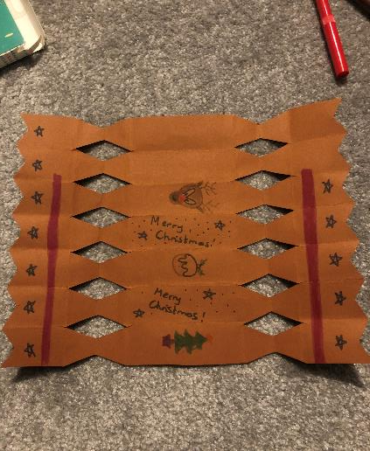
4. Decorate your cracker, leaving 2 sections blank (these will be covered up).

Slide 6
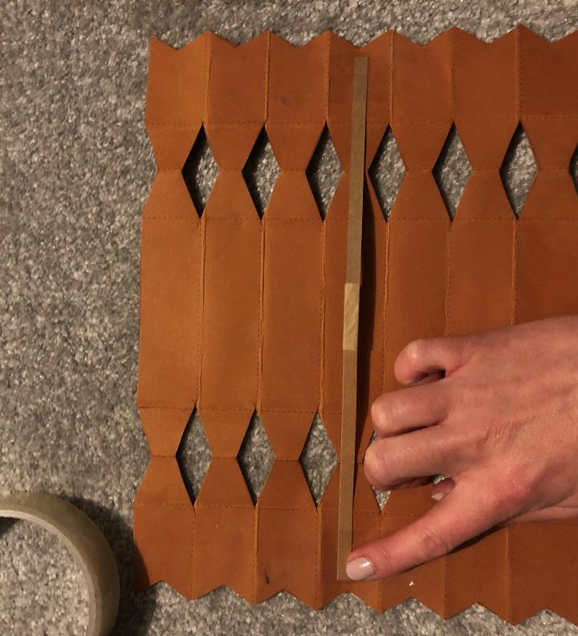
5. Use sticky tape to stick in the cracker snap. Make sure you stick down both ends.

Slide 7
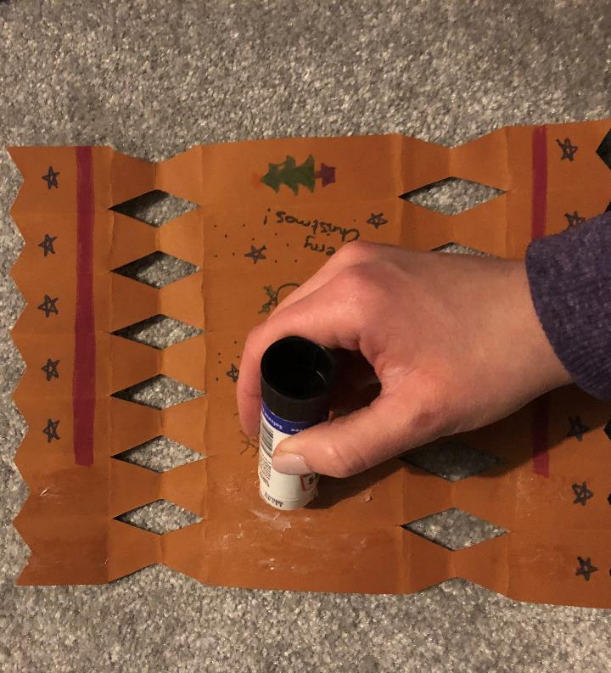
6. Put glue on the two blank sections of your cracker.

Slide 8
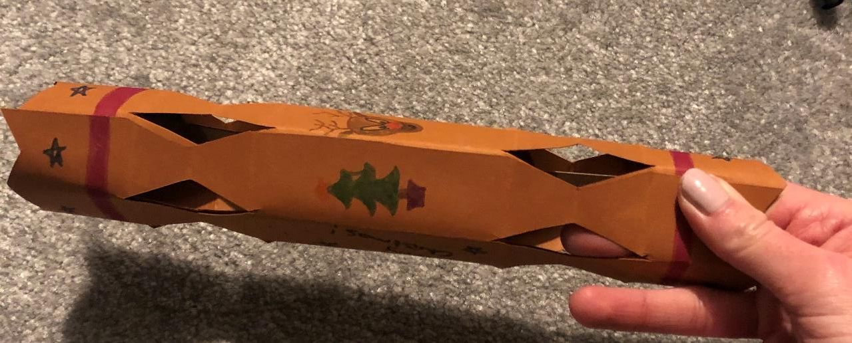
7. Roll your cracker up and hold it for a minute or two to allow the glue to set firmly.

Slide 9
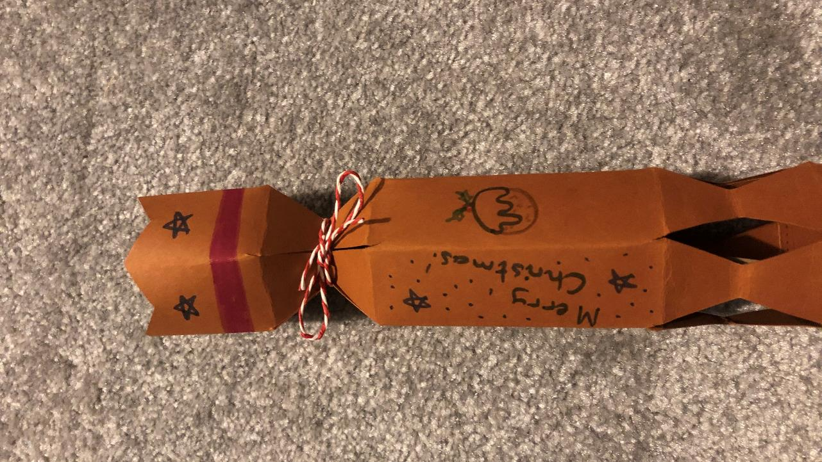
8. Cinch in one end of your cracker, then tie a bow using the string to hold it in place.

Slide 10
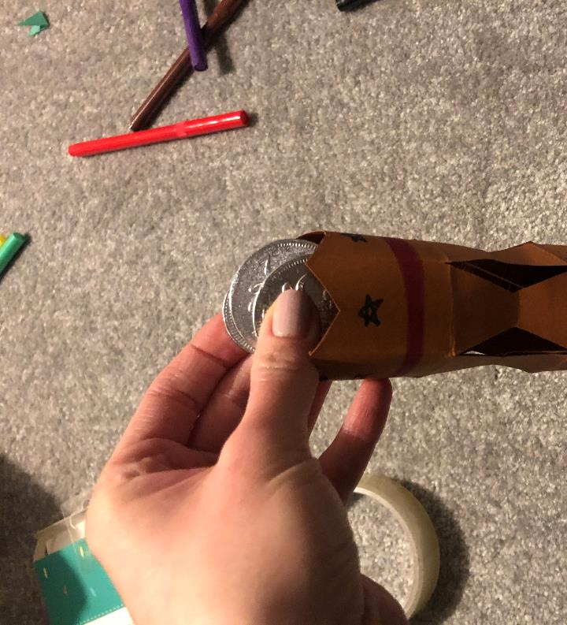
9. Carefully drop in your coins, joke and cool fact, then tie up the other end of your cracker.

Slide 11

Done!

